Slide 1
Semantics
The study of meaning

Slide 2
Meaning
How do we define meaning?
What is it?
How do we study it?
Notes:
That which is communicated

Slide 3
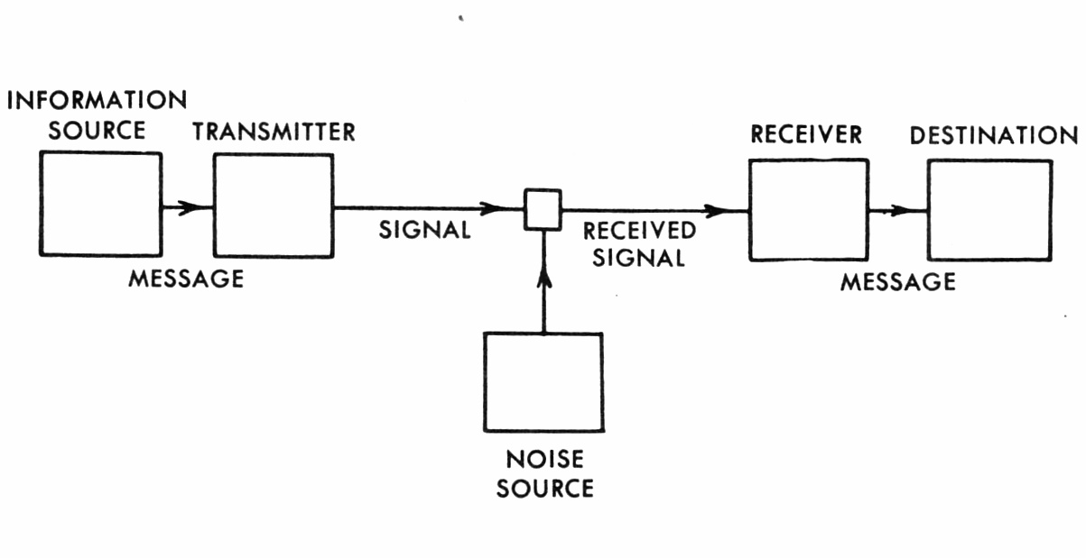
Models of Communication
Shannon-Weaver’s Model of Communication (1949)
Notes:
One of many models-one of the first and has endured the ages

Slide 4
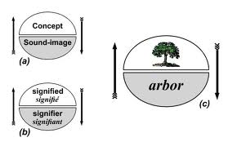
The Sign
Ferdinand de Saussure’s sign

Slide 5
Semiotic triangle
Ogden and Richard’s ‘Semantic/Semiotic triangle’
MENTAL CONCEPT
EG tree
WORD EG arbre ACTUAL TREE
IN THE WORLD
‘A sign is something which stands to somebody for something in some respect or capacity’ (Charles Sanders Pierce)

Slide 6
Semiotics
Study of sign and sign systems
What does this have to do with language?

Slide 7
Key terms
Content words vs Function words
Semantic properties-information which the speakers of a language associate with a word
Denotation-meaning constantly associated with a word i.e. dictionary definition
Connotation-associated meaning i.e. subjective in nature
Semantic field-set of words related in meaning
Etymology-study of word history and origins

Slide 8
Changes in meaning
SENSE | CONNOTATION
Broadening *acquires additional meaning to those it already had EG bird-from briddle meaning young birds only in the nest | Deterioration *takes a less positive meaning EG spinster-from ‘one who spins’ to ‘unmarried woman’ disease- ‘discomfort’ to ‘illness’
Narrowing *refers to only part of its original meaning EG meats-any kind of food | Elevation *adopts a more positive value EG pretty-OE praettig ‘crafty/sly’ dude-1883 referring to ‘a dandy’
Shift *change in word usage EG gay or guy
Notes:
Dandy-man who affects an exaggerated fastidiousness in dress, speech and deportment;

Slide 9
Activity 1
Determine the various meanings for the following sentences:
The school teacher beat the boy with the wooden leg.
Jack shot the bear in his pajamas.
The lamb is ready to eat.
Flying plans can be dangerous.
She only asked Williams for two extensions.
She didn’t reject him because he was depressed.

Slide 10
Activity 2
Find verbs that share this semantic property:
motion
contact
creation
sense

Slide 11
Activity 3
Connotations
The following eight words refer to smelling: smell, odour, fragrance, stink, aroma, stench, scent, perfume. Rank them, from most unpleasant to pleasant.
Using a good dictionary, find the earliest recorded date for each of the words. What general correlation do you notice between the length of time a word has been used to refer to smelling and its tendency to deterioration? Why do you think these words deteriorate in this way?

Slide 12
Activity 4
Trace the history of two of the following words. How would you define them according to morphemes-how would you classify them now?
List of words: hussy, werewolf, lord, gossip, cobweb, daisy, lukewarm, umbrella, wiseacre, news, quince, digest, prepare, pregnant

